Slide 1
Equity offerings
Kevin Chiang, UVM

Slide 2
Outline
I. IPO structure and process
2. IPO pricing
3. SEOs

Slide 3
IPOs
Initial public offering: the first sale of a firm’s shares to the public and the list of shares on a public stock market.
Why firms want to do IPOs?
  (1) Turn shares into cash: informational asymmetry?
    Raising equity capital to pay down debt or fund firm growth: investing new projects, acquisition, expanding marketing, etc.
    Exit: founders and senior employees cash out; private equity/VC funds exit.
  (2) Publicly traded shares are acquisition currency. Future acquisitions can be pay for by publicly traded shares with liquidity.
  (3) Improving firm image and reputation.
  (4) Reduced cost of capital.

Slide 4
Microsoft’s potent acquisition currency
Microsoft’s planned acquisition of GitHub, a software development company, is not close to the company’s largest, and it will not have a big, immediate impact on profits.
But the deal is a milestone because it reveals the degree to which the rise in Microsoft’s stock has bolstered its heft as an acquirer.
Microsoft’s stock has gone up more than 200 percent since Microsoft agreed in 2013 to pay $7.2 billion in cash for Nokia’s handset and services operations. That price tag amounted to 2.6 percent of Microsoft’s total market value back then. The $7.5 billion Microsoft is paying for GitHub is just under 1 percent of Microsoft’s current market capitalization. This lessens the financial hit if the acquisition falls short of expectations, but increases the upside if it outperforms.
Source: NYT, 06/04/2018

Slide 5
Costs
The costs of doing an IPO: fees, disclosure requirements, compliances costs, monitoring from activist and institutional investors.
Fees (gross spread): mostly about 7% of IPO proceeds, but it can be as low as <2% for large, hot, highly visible IPOs; e.g., Facebook 1.1%; Twitter 3.25%.

Slide 6
Primary markets and secondary markets
Primary markets: those markets in which securities are first sold to the public; e.g., the IPO market.
Secondary markets: those markets in which previously issued securities are bought and sold; e.g., NYSE, Nasdaq, SSE, etc.

Slide 7
IPO offering structure: Which shares?
Primary offerings: those IPO offerings in which newly issued shares are sold to the public.
  Proceeds go to the firm.
Secondary offerings: those IPO offerings in which existing shares are for sale.
  Proceeds go to founders and existing shareholders.
  Cash out; usually not a good sign.
Many IPOs are a combination of primary offerings and secondary offerings.
Most issues have around 20-30% of shares (free float) for IPO sale.
Facebook put 11% of shares for IPO sale, which is unusually low.

Slide 8
2017 minimum free float regulation
“The Securities and Exchange Commission (SEC) has ordered all companies planning to conduct an initial public offering (IPO) to make way for a minimum public float of 20 percent.”
“This move would boost liquidity, improve price discovery and lessen opportunities for price manipulation, the SEC said Tuesday.”
“All public companies must also maintain a minimum public ownership (MPO) of at least 20 percent.”
The current MPO is still 10% (as of 08/2020).
Source: Inquirer.com, 11/23/2017

Slide 9
IPO offering structure: To whom?
IPO is a “public offering” because it is directed to all investors.
An offering can be a “private offering/placement” if it is entirely directed to institutional investors (we will discuss private placement when we talk about debt offerings).
The vast majority of IPOs are divided into tranches.
Retail tranche: a subset of the offering to retail investors.
  Usually 15-20% of total IPO offering.
Institutional tranche: a subset of the offerings to institutional investors and regulars.
  Usually 80% of total offering.
Sometimes, there are “friends and family tranche” and “employees tranche.”

Slide 10
IPO offering structure: Where?
The offering can be domestic.
The offering can be international; that is, selling shares in home country as well as selling to foreign investors.
International offerings tend to target international institutional investors because the compliance cost for international retail offering is very high.

Slide 11
IPO process
The process takes about 4-6 months.
The key steps of the IPO process is in Table 3.1, p. 53.

Slide 12
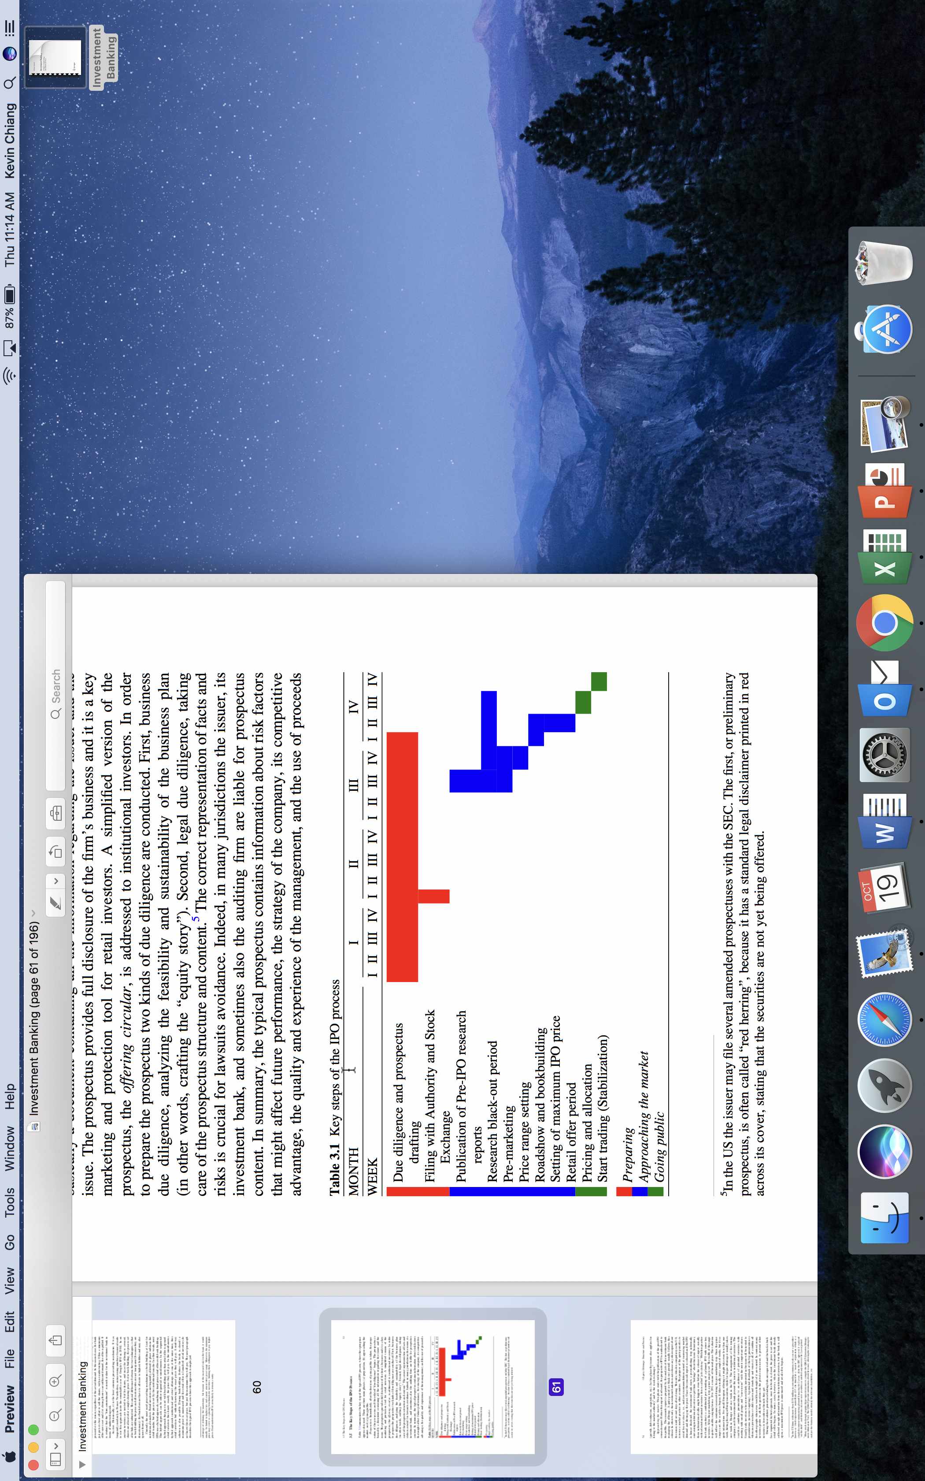
Table 3.1

Slide 13
At the very beginning: winning the mandate
In most cases, many banks have been speaking to and developing relationships with the potential IPO candidate for years; so, it is usually not surprising to these banks when the firm decides to do IPO.
The firm is likely to do a beauty contest and invites bank to pitch for the deal.
The initial pitch is often done with inputs from both industry coverage bankers and ECM bankers (e.g., the state of IPO market and expected IPO process and timeline).
IPO “pitch book” is prepared by each bank for the presentation and it usually contains at least the following set of information:

Slide 14
Usual IPO pitch book format
  1. Bank overview: Bank’s organization, reputation, league table, recent notable deals, experiences, team members and their experiences and expertise.
  2. Market/situation update/overview: recent IPO deals and recent trends in the IPO market and their implications on the deal. These few slides are often provided by ECM.
  3. Company positioning: business, financial, etc.
  4. Preliminary valuation overview: rough estimate about the possible price range for the deal based on recent transactions.
  5. Summary/recommendation: listing location, structure, and timing of the IPO process, etc.
  6. Appendix.

Slide 15
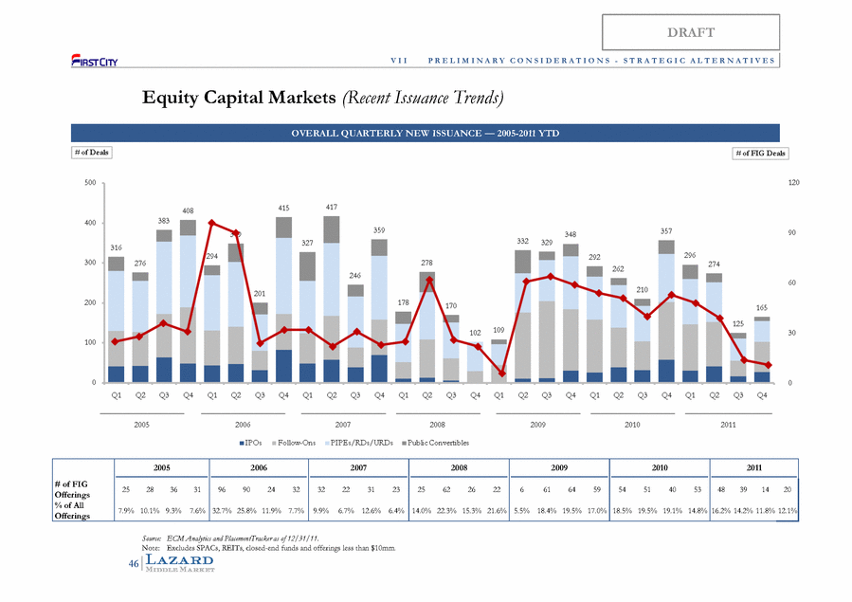
An example of market slides from ECM

Slide 16
“Single driver” pitch: Why only me?
“Investment banker Michael Grimes's audacious, successful pitch to minimise input from other underwriters put Morgan Stanley in a position to exert unusual control over Facebook's IPO.”
“Grimes's pitch to be Facebook's sole driver echoed what he had told other tech companies in recent years. A page of his pitch book to other companies, which he calls the "Driver/Navigator Model," shows a black sports car. A company about to go public, the pitch reads, must choose between a "single driver [who] operates the steering wheel, gas, brake and clutch," or the "two driver model, where the car literally has an extra steering wheel, gas, brake pedals and clutch for a second driver." Morgan Stanley, the pitch says, "favours the sole bookrunner approach.”
“But it also turned the veteran Silicon Valley investment banker and his firm into targets for criticism when Facebook's IPO swiftly turned bad for many investors.”
Source: WSJ, 06/18/2012

Slide 17
Phase 1: Preparation, I
After a leading bank is awarded with the mandate, the deal is live.
The bank and the issuer will kick off the preparation phase with a (series of) organizational meeting whose participants include all banks involved, the issuer’s management, legal counsel, and accountants.
Quiet period: the management should not talk about or promote the IPO.

Slide 18
Phase 1: Preparation, II
This working group needs to address the following issues:
  Structure of the offering: the size of the offering, lock-up agreement with the issuer, distribution/syndication, selection of listing exchange/market and symbol, etc.
  Time schedule and assignment of tasks: diligence assignments, drafting sessions, shareholder communications, filing, SEC review period, roadshow, pricing, closing, etc.
  Legal consideration: outstanding claims, loan agreement restrictions and other restrictions to offer shares, possible lawsuits, etc.
  Publicity: quiet period, industry presentations, press releases.
  Financial and accounting preparation: audited financial statements, identify any unusual accounting items reacquiring advance discussions with the SEC.

Slide 19
Offering structure: Listing market
Xiaomi, the gadget maker, announced on Thursday that it would list in Hong Kong, the first company to do so after the rule changes.
In the past, Chinese entrepreneurs like Jack Ma of Alibaba chose to list their shares in markets, like New York, where they could operate as if their companies were still private. They were able to offer so-called dual-class shares.
Until last week, Hong Kong, which has stricter rules than New York, had not allowed such listings… As part of the listing, which could come as soon as June, Xiaomi will offer dual-class shares… It could raise as much as $10 billion.
As a comparison, Facebook IPO offering size was $16.08 billion.
Source: NYT, 05/02/2018

Slide 20
National Security Law and the future of HK as an IPO market
The principle of “One Country Two Systems”, promised to last for at least 50 years by China in 1997, has enabled Chinese investors, including those of the state, to maintain ultimate corporate control in China under mainland commercial law, while accessing international capital in Hong Kong under Hong Kong law. The Hong Kong Stock Exchange ranks as the world’s top-performing stock exchange in terms of initial public offering (IPO) proceeds, amounting to US$40.4 billion in 2019. In the first quarter of 2020, 96% of total IPO funds raised were for mainland companies.
The National Security Law of 2020 imposed on Hong Kong reflects the principle of “One Country One System.”
What is the future of HK?
Source: The Interpreter, 07/2020

Slide 21
Phase 1: Preparation, III
Preparing prospectus (S-1, also called “red herring”): a document containing information about the issuer and the issue.
  A key marketing tool for retail investors.
Offering circular: a simplified (or different) version of the prospectus for institutional investors and regulars.
  These sophisticated investors prefer a more to-the-point document.
S-1 and offering circular are often jointly done by industry coverage bankers and ECM bankers.
Apply for listing to the SEC and the stock exchange/market.

Slide 22
Due diligence
A major purpose of due diligence is to limit potential liability.
Business due diligence: learning and analyzing the feasibility and sustainability of the business plan (i.e., crafting the “equity story”).
Legal due diligence: ensuring representation of (accounting and financial) facts and risks and taking care of the prospectus content to avoid lawsuits.
Processing investors’ requests and looking into the target’s financial statements, contracts, tax, legal, regulatory, environmental, IP issues.
Due diligence meetings and calls with clients and investors.
Due diligence (including meetings and calls) are often led by industry coverage bankers. This may be so not just for IPOs, but also for M&As, debt issuance, etc.

Slide 23
Opaque natures of private firms
Fine print in WeWork’s IPO paperwork shows that some investors, including SoftBank, are protected from losing money if the company lists below the price where they last valued it.
WeWork’s provision, known as a ratchet, could give $400 million worth of additional shares to SoftBank in the event of a weak IPO performance
he provision speaks to how opaque private valuations can be.
Source: CNBC, 09/2019

Slide 24
Equity story
“Our team at PwC has helped numerous clients prepare for an IPO – from pre-kick off with a readiness assessment, through development and filing of the S-1, to pricing the IPO and finally to being a public company; and all the steps in between. One area where I see companies consistently challenged is with their equity story.”
“The equity story is really the foundation of any successful IPO. The purpose of the equity story is to create a vision for the organization while serving as a compelling rationale for why investors should be interested in buying the stock. Investment bankers will rely on it to determine the marketability of the company and, most importantly, the valuation, while lawyers will use it to make sure the disclosure in the S-1 is correct.”
“Investors will want to make sure that the business model and its future prospects, the market growth and the company’s ability to monetize its customer base all “hang” together.”
Source: Daniel Klausner, MD, PwC Deals, PwC.com

Slide 25
Phase 2: Approaching the market
Starting with the publication of the pre-IPO research report by unaffiliated (to underwriters) analysts. Pre-IPO research reports are rare in the U.S., but very common in China.
Black-out period: Bankers do not publish research reports on the issuer until the SEC finishes its review and declares the filing effective to avoid accusation that research reports are used to boost market demand.
Pre-marketing: informal, private talks with institutional investors and regulars to get their “feelings” about the issue.
Respond to SEC comments whenever they emerge.
prospectus are amended (S-1/A) with possible price range revision to reflect new information arrival during this phase.
Analysts and the management make presentations to banks’ sales forces.
Prepare institutional sales and retail sales memos for sales forces.

Slide 26
SEC’s IPO comments (source: PwC)

Slide 27
Chinese IPOs
Nasdaq Inc is set to unveil new restrictions on initial public offerings (IPOs), a move that will make it harder for some Chinese companies to debut on its stock exchange.
The move is being driven largely by concerns about some of the Chinese IPO hopefuls’ lack of accounting transparency and close ties to powerful insiders.
Last month, Luckin Coffee, which had a U.S. IPO in early 2019, announced that an internal investigation had shown its chief operating officer and other employees fabricated sales deals.
The proposed new rules will also require auditing firms to ensure that their international franchises comply with global standards.
Source: CNBC, 05/2020

Slide 28
Price-setting mechanisms
3 mechanisms to price and distribute IPO shares:
(1) Open price (book-building): the IB(s) interact with potential investors and incorporate their feedback to arrive at an offer price.
(2) fixed price: the offering price is set prior to requests of shares being submitted.
(3) auction: a market clearing price is set to be the offering price once bids are submitted from potential investors.

Slide 29
Auction
Google decided to raise money via an auction.
Google's auction produced a clearing price of $85. And yet the first trade yesterday was at $100, providing investors who bid shrewdly with an 18 percent pop.
Google announced it intended to pay underwriters a measly 3 percent commission. In response, investment bankers adopted a passive-aggressive attitude. While they went through the motions of marketing the stock, they generally failed to signal their buddies at hedge funds, mutual funds, and institutional investors that they absolutely, positively had to get in on this offering. The number and volume of professional money managers who, as a result, loudly proclaimed their lack of interest in Google at the initial $108-$135 price range may have helped suppress demand. The fact that Google had to cut both the price and the size of the offering was a victory for investment bankers.
Source: slate.com

Slide 30
Book-building (open price)
This is the standard approach in the US.
Based on bankers’ valuation and pre-marketing, a price range is suggested to the target market of institutional tranche at the beginning of the book-building process.
Presentation by the management (about 30 min + Q&A) is made during a “road show” (often 8-10 days) in major cities, such as NYC, Boston, Chicago, Huston, LA, SF, etc.
Road shows are often led by industry coverage bankers.

Slide 31
Some slides from a roadshow

Slide 38
Road show is not really for retail investors
“Facebook Inc’s initial public offering pitch played to some bad reviews in New York, so for its Boston audience on Tuesday, the 30-minute video was scrapped and the company took more questions from analysts and potential investors.”
https://www.youtube.com/watch?v=TyF2UAaMe_E
Source: Reuters, 05/08/2012

Slide 39
Bids
Institutional investors and regulars are asked to provide non-binding indications of interest (bids).
In addition to group presentations, often 100+ one-to-one meetings/presentations.
The book is built from bids (usually built by ECM), and the information contained within it is used for pricing (usually handled by ECM bankers) the shares.
The book is closed only if there is sufficient demand; otherwise, the offer would be abandoned.
Note that institutional investors and regulars are information providers, whereas retail investors are not.

Slide 40
Unhappy IPO = unhappy SEC
“Facebook Inc. (NASDAQ:FB)’s … shares lost almost half their value within a few months of the Facebook IPO.”
“it turned out the lead underwriter of the IPO had downgraded the firm just days before the IPO and told its large clients about the downgrade before publishing the report… but smaller, private investors never got tipped off”
“the SEC Launched a probe… Facebook Inc (NASDAQ:FB) has been cleared in the SEC’s probe… Morgan Stanley said that making disclosures only to select investors was “standard practice” in the industry.”
“Legal experts say… it’s against the law for the underwriters to “publish” research on pre-IPO companies, but there’s no law preventing brokers in the firm advising key clients of new information in person or over the phone.”
“The law basically says underwriting firms can disseminate IPO information privately, but not publish it in the public purview.”
Source: Value Walk.

Slide 41
Phase 3: Going public
SEC declares registration effective.
The information in the book is used to finalize the offering price.
Pricing meeting: the issuer and the IB(s) set the offering price at this meeting.
Underwriting: the IB(s) buy shares from the firm, then sell/allocate shares to investors (usually within 24 hours, and are at (little) risk (inventory risk) of not being able to sell all shares.
Within the institutional tranche, share allocation is made on a discretionary basis; long-term buy and hold investors who do not flip tend to have more allocation.

Slide 42
Going public, II
Within the retail tranche, share allocation is made on a non-discretionary basis: either a pro-rata basis or a lottery if over-subscribed.
Stabilization: After trading begins, the IBs support share price by placing buy orders to protect their reputation and relationship with institutional investors and regulars.
Closing: wiring of funds.
Provide on-going research coverage and maintain post-deal relationship.

Slide 43
Stabilization: Lock up
Lock up provision: contractual agreement with the issuer’s pre-IPO shareholders/insiders, which restricts them from selling shares for a period of time, say 180 days or 1 year.
This reduces the supply of shares and helps stabilization.
This also sends out a good signal that insiders will not cash out.

Slide 44
Stabilization: Overallotment
Overallotment: the IB(s) usually sell more shares (to institutional investors, regulars, and retail investors) than are being offered, usually by 15%.
This effectively creates a pre-IPO short position.
This gives the IB(s) capacity to buy back (i.e., stabilization) shares after the IPO.
Overallotment option (i.e., Green Shoe option): the issuing firm usually grant (without charge) the IB(s) a call option to purchase shares from the issuer at the offering price within the following say 30 days.
If share prices go up after IPO, the IB(s) exercise the option and cover its short position without loss.
If share prices go down after IPO, the option is not exercised. The IB(s) buy shares in the market (i.e., stabilization) and return the shares borrowed/shorted.

Slide 45
Syndicate
The issuer typically selects a book-runner (i.e., lead manager) who won the IPO mandate.
But the IPO is usually assisted by more than one IB.
IPO syndicate: a group of IBs enter a set of formal contracts (i.e., inter-syndicate agreements) to assist an IPO, and the syndicate will be dissolved whenever the offering is completed.

Slide 46
Syndicate structure (Table 4.1)
Managing Group: Book-Runners
Non-Managing Underwriters: Managers
Selling Banks: Co-Managers
Managing Group
+ Non-Managing Underwriters
=Underwriting Group

Slide 47
3 groups of syndicate
1. The managing group: composed by the mandate-winning book-runner and other joint book-runner(s), if any.
  Responsible for due diligence, roadshow, book-building, price discovery, allocation, and stabilization.
  Management fee is about 20% of gross spread.
2. The underwriting group: composed by the managing group and non-managing underwriters (called managers).
  Underwriting fee is about 20% of gross spread.
  After deducting all expenses, this fee is shared according to the % of shares underwritten.

Slide 48
3 groups of syndicate, II
3. The selling banks (called co-managers): in addition to the selling efforts by the underwriting group, selling banks provide additional selling on a best effort basis (i.e., do not underwrite and do not guarantee how much they can sell).
  Selling concession (fee) is about 60% of gross spread.
  This fee is shared according to who brings in an investor’s order.
  Note that book-runner(s) have discretion on the allocation of shares and do allocate more shares to their own selling force and earn far more selling concession.
ECM bankers interact with salespeople (including crafting sales force memo) and lead the selling process.
Sales force/team memo: a marketing document outlines why investors would want to buy the offered shares.

Slide 49
One or more book-runner(s)?
Grimes and Morgan Stanley, in consultation with Facebook, made several unusual moves, say people involved in the process. They shut out the two other lead banks, JP Morgan Chase and Goldman Sachs, from many meetings with prospective institutional buyers, making it harder for those bankers to judge demand for the shares, these people say. They supported increasing both the number of shares offered and the price range, a rarity, despite misgivings expressed by a Goldman executive, they say.
Goldman and JP Morgan underwriters had access to the book of orders and spoke with some large investors, according to bankers involved in the process. But because they weren't included in any one-on-one roadshow meetings, they didn't hear firsthand how investors reacted to Facebook's story, these bankers say.
Source: WSJ, 06/18/2012

Slide 50
Economic functions of syndicates
1. Risk sharing: instead of having one bank suffers all lose if it happens, the risk can be shared by the other underwriters.
2. Information improvement: different banks have different institutional and regular clients; thus by having a syndicate, there would be more information providers.
3. Enhancing certification: banks use its reputation to certify the IPO. More banks means more certification.
4. Research coverage: more banks means that more analysts from these banks would cover the issuer. Analyst coverage is important to any firm; it improves trading activities and liquidity.
5. Market making: if the issuer is listed in a dealer market, such as Nasdaq, underwriting members are likely to continue to be a market maker after the IPO to facilitate liquidity and a orderly market for the new shares.

Slide 51
Syndicate dynamics
Syndicates look like exclusive clubs.
The same (or almost the same) group of banks tend to come together repeatedly with the leadership position revolving among a table.
Reciprocal participation: relationships among banks are important aspect of the syndicate dynamics.
There is a clear sense of “league.” Most reputable banks do not participate in a small IPO’s syndicate.
For a large IPO, analyst’s prestige and reputation plays a role in whether a bank will be invited into the syndicate.

Slide 52
More on informational asymmetry, book-building, and pricing
As discussed earlier, IPOs are plagued by informational asymmetry.
High informational asymmetry means high uncertainty.
High uncertainty makes pricing difficult; thus, the fee for IPO is much higher than other types of security offerings.
Banks use book-building to extract useful information.
The information generated reduces informational asymmetry and pricing uncertainty
Information providers: institutional investors and regulars.
With better information and lower informational asymmetry, book-building leads to price discovery and a better (higher) offering price.

Slide 53
What information?
Common perception (e.g., in the press): roadshows are used to present the issuer to institutional investors and regulars.
The reality is the other way around: a roadshow is an opportunity that banks and the issuer obtain two types of information from institutional investors and regulars:
1. Hard information: investors’ insight about the firm that, for example, they learn from the firm’s competitors.
2. Soft information: investor’s demand (bids) for the issue.

Slide 54
3 types of bids for institutional tranche
1. Strike bid: a request for a specific number of shares (or a given amount of money) regardless of the offering price (analogue: market orders).
2. Limit bid: with the maximum price that the bidder is willing to pay for a specific number of shares (analogue: limit order).
3. Step bid: the bidder submits a demand schedule as a step function.

Slide 55
The demand curve
By aggregating all bids, book-runner(s) have the demand curve for the issue.
Like most demand curves, its slope is non-positive: that is, as the offer price increases, share demand decreases.
With sufficient demand, the offer price will be set such that all of most important clients’ bids will be allocated and a reasonable amount of not-so-critical bids will be excluded.
Note that the allocation is at the discretion of the book-runner(s).

Slide 56
Why allocation discretion?
Allocation discretion is used to reward those institutional investors and regulars who cooperate in providing useful information.
Without any reward, potential investors would have incentives to understate their interest in order to depress the price at which they purchase shares.
Cornelli and Goldreich (2001) study IPO rationing (shares allocated relative to requested):
  Large bids are favored because large bidders are on average better informed.
  Limit bids and step bids are favored.
  Bids submitted later in the book-building process and revised bids are favored.
  Regulars’ bids are favored.
  A domestic (relative to international) institution is favored because a domestic investor knows more about a domestic firm.
  As mentioned earlier, bids submitted to book-runner(s) are strongly favored.

Slide 57
Reward in the form of underpricing
Favored allocation alone is not a reward if post-IPO share price is lower than the offering price; that is, overpriced. This is the worst thing could happen to banks because it leaves bad taste for their clients. Remember: reputation is very important here.
To compensate information providers’ efforts, banks would need to deliberate underprice the IPO such that there is some money left on the table for institutional investors and regulars.
Short-term underpricing: on average, IPOs would see an about 15% price increase for their first-day’s trading.
There is also expectation that banks would support the price for a certain period of time.
Balance act as an intermediary: a little bit of underpricing to induce information generation and to make investors happy, but not to really piss off the issuer so that the deal is able to go through.

Slide 58
The art of pricing: How much left on the table?
“Pricing an IPO is as much art as science. A lead underwriter like Morgan Stanley must balance the interests of the stock issuer and investors. Companies like Facebook want a high offering price so they can raise more money. Investors taking a risk on a new stock want a price low enough that it is likely to pop when trading begins.”
“Although Facebook shares rose 10% late last week, they are still down 21% from the offering price, the steepest-ever decline over the first month for an IPO of $1bn or more of a US-based company, according to Dealogic, leaving many investors sitting on big losses and regulators asking for explanations.”
Source: WSJ, 06/18/2012.

Slide 59
Pricing and the size of offering
“As the roadshow concluded early the following week, demand for Facebook IPO shares totalled more than five times the shares available for institutional investors.”
“Morgan Stanley and Facebook wanted to raise the IPO price... increasing the IPO range to $34 to $38 a share, from $28 to $35.”
“On May 16, two days before the IPO, Facebook disclosed it was increasing the number of shares by nearly 84m, or 25%.”
“It was a gutsy move. Just 3.4% of all US-listed IPO deals since 1995 have increased both the number of shares and the price range of their IPOs before pricing, according to Dealogic.”
“Tim Ghriskey, a hedge-fund manager with Solaris Group in New York, says the news spooked him… When the IPO's size increased, he says, he pulled out entirely, deciding to wait and see how Facebook traded once it went public.”
Question: Why is increasing size such an unusual move? Think: information asymmetry.
Source: WSJ, 06/18/2012.

Slide 60
General Qs
Q: Walk me through the process of a typical IPO.
Q: Tell me an IPO deal that interested you recently.

Slide 61
Seasoned equity offerings (SEOs)
SEO: public equity offering from a publicly traded firm.
Because the share price is observable, pricing for an SEO is much easier relative to an IPO.
Fee is thus lower: the gross spread is about 3-5%.
An SEO can be done via either of the following two methods:
(1) a bought deal: a bank buys the shares and re-sell them as quickly as possible to institutional investors.
  The difference between purchase price and sell price is the IB’s profit.
  No fee.
(2) an accelerate book-building.
  Similar to IPO book-building, but with fewer investors and over a shorten period.

Slide 62
Last resort?
SEOs are not frequent because whenever they are announced, the share prices of the existing shares drop.
SEOs are done at the expense of the existing shareholders.
Why? Can you come up with an explanation based on informational asymmetry?
If the deal size is $100 million, and it is a primary offering with new shares being sold, the existing shareholders would suffer a loss in market capitalization in the amount of about $30 million (30%).
If it is a secondary offering with old shares being sold, the existing shareholders would suffer a loss in market capitalization in the amount of about $80 million (80%).

